Slide 1
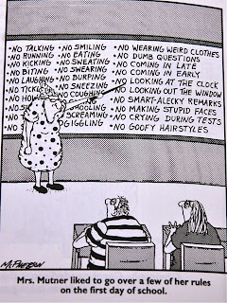
MissWallis’s Classroom
Be responsible
Be respectful
Be safe
Policies

Slide 2
Be Responsible
Students must hand in all assignments on time unless special arrangements have been made. Excused absences allow students seven days to complete missed assignments. Unexcused absences result in a zero.
A late assignment will be accepted for full
credit provided it is turned in with a late
homework pass. Students will receive 3 per
quarter. The passes are non-transferrable
and may not be used during a following
marking period. Without a pass, late work
WILL NOT BE ACCEPTED.

Slide 3
Be Responsible
Come to class PREPARED and ON TIME.
Be in your seat working when the bell rings (In fact don’t even enter the room until you’re ready to sit down and work).
Bring necessary materials: textbook, folder/binder, notebook, silent reading material, pencil, and pen. YOU WILL NOT BE ALLOWED TO GO TO YOUR LOCKER FOR MISSING ITEMS WITHOUT A HALL PASS.

Slide 4
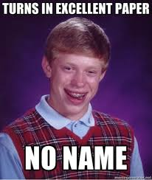
Be Responsible
Put your name and class period on EVERY PAPER.
NO NAME = NO GRADE.
Anything you need to hand in should go in the “INBOX” wire basket in the back of the room
If it is make-up from an excused absence, please put the date you were absent or it may be confused for late work which will receive no credit without a late homework pass.

Slide 5
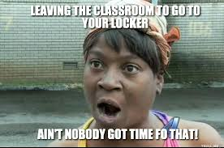
Be Responsible
NO LEAVING THE CLASSROOM. Leaving the class will be on an EMERGENCY BASIS ONLY.
You are to conduct your personal business outside of class. It is unfair to expect special favors to get books, pens, etc…
You will be allowed 3 passes each quarter. Should you lose your passes, run out or not bring them to class, too bad. If you have extra passes at the end of the quarter each will be given 3 extra credit points. These passes are NOT TRANSFERRABLE.

Slide 6
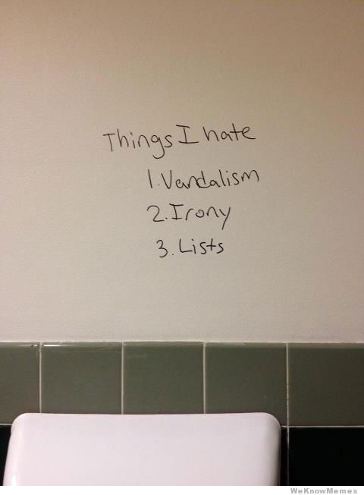
Be Respectful
Respect the school property and the classroom
Don’t draw on the desks, walls, etc…
Don’t write on the board unless told to or given permission
Don’t leave your personal papers/belongings lying around the room. They WILL be thrown out no matter how important they look
Clean up any messes you make

Slide 7
Be Respectful
Respect your peers.
No swearing or obscene language both verbal or written.
At no time will a student belittle or make fun of another student. Show respect to your classmates at all times.
Respect the education of your peers by providing them with a quiet work environment. This means you need to keep your discussions to a reasonable volume.

Slide 8
Be Respectful
Respect your teacher and other staff members.
DO NOT ARGUE OR QUESTION AUTHORITY.
Listen to your teacher. Don’t talk while I’m talking. (Most of the time what I have to say is pretty important).
Again, no cussing or inappropriate language.

Slide 9
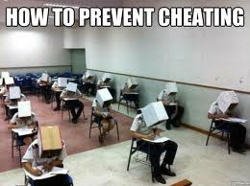
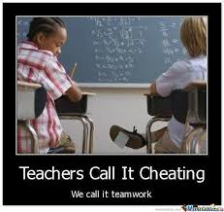
Be Respectful
Respect the teacher by being honest.
No lying or cheating. Cheating will result in an automatic zero!
For this reason, during a quiz or test, there is NO TALKING, even if you and the person you would like to talk to are both done.
The same goes for plagiarism.

Slide 10
Be Safe
The classroom should be a safe environment for all students and the following will not be allowed:
Throwing objects across the room (this includes small items such as lip gloss, pencils, etc…)
Touching others (i.e. wrestling, hugging, tripping, hitting, kicking, piggy backs) Just keep your hands to yourself.
Bullying. All students should feel welcome in the classroom.

Slide 11
Cell Phone Policy
All teachers will be enforcing the same cell phone policy. No phones will be allowed in the classroom or hallways.
You may use your phones in the locker bays before/after school and in between classes.
If I see or hear your phone in class, I will confiscate it.

Slide 12
Consequences
Breaking a rule will result in a number of consequences depending on the severity of the situation.
The stink eye
A verbal warning
Detention Slip
ISS
Behavior Reflection Sheet
Not allowed back to class until completed
OSS
Parent phone call
Parent meeting

Slide 13
Classroom Routines
Daily Bellringers
Weekly Vocabulary and Spelling
Quarterly Book Reports
Exit Slip
Dismissal

Slide 14
Grades
Grade Scale:
District wide: Honors District Wide:
93-100 A 96-100 A
90-92 A- 94-95 A-
87-89 B+ 92-93 B+
83-86 B 88-91 B
80-82 B- 86-87 B-
77-79 C+ 84-85 C+
73-76 C 80-83 C
70-72 C- 78-79 C-
67-69 D+ 76-77 D+
63-66 D 72-75 D
60-62 D- 70-71 D-
<60 F <70 F

Slide 15
Grades
Grades in Miss Wallis’s classes are weighted by categories:
Assessment (60%)
Tests, quizzes, unit projects/papers
Practice (40%)
Bellringers, homework assignments, worksheets, exit tickets, prewriting activities, etc…

Slide 16
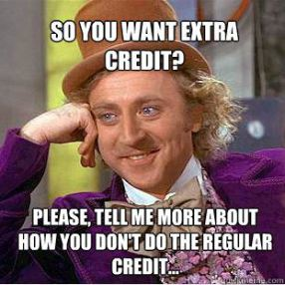
Extra Credit
Kleenex Box or package of pencils (1 per quarter) = 5 points
Attend a fine arts event (either in Chisholm or elsewhere) such as a play, band/choir concert, art show, etc… Bring back a program along with a paragraph summarizing the event. If you were a part of the event, you will still need a program but include a reflective paragraph on your performance. = 5 points
Fill out a book recommendation form. = 5 points (1 per quarter)
Find a typo in Miss Wallis’s tests or worksheets. = 1 pt. per typo
Find one of your vocabulary words in everyday print such as a magazine, book, or newspaper. (Sorry, internet articles don’t count). = 1pt per word
Leftover hallway/bathroom or late homework passes. =3 points each, non-transferrable and cannot be used the following quarter
Other opportunities will be available throughout the year.

Slide 17
Questions??

